Slide 1
Bed head signs
These PowerPoint slides are designed for you to adapt to your local procedures.
You can cut and paste the relevant images on the subsequent slides to the bedhead template signs
For example: if you never perform a Bjork Flap tracheostomy, remove the image
Add your local emergency contact details
This is best saved as a pdf (Save as..)
We have included the 2 standard bedhead signs
You can add the algorithms to make a double-sided bedhead sign

Slide 2
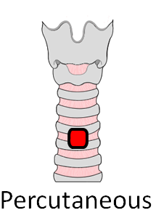
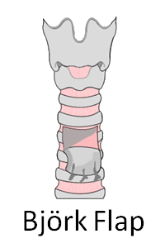
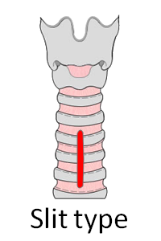
This patient has a TRACHEOSTOMY
There is a potentially patent upper airway (Intubation may be difficult)
Surgical / Percutaneous
Performed on (date) ..............................
Tracheostomy tube size (if present) ...............
Hospital / NHS number ..............................
Notes: Indicate tracheostomy type by circling the relevant figure.
Indicate location and function of any sutures.
Laryngoscopy grade and notes on upper airway management.
Any problems with this tracheostomy.
Emergency Call: Anaesthesia ICU ENT MaxFax Emergency Team
www.tracheostomy.org.uk

Slide 3
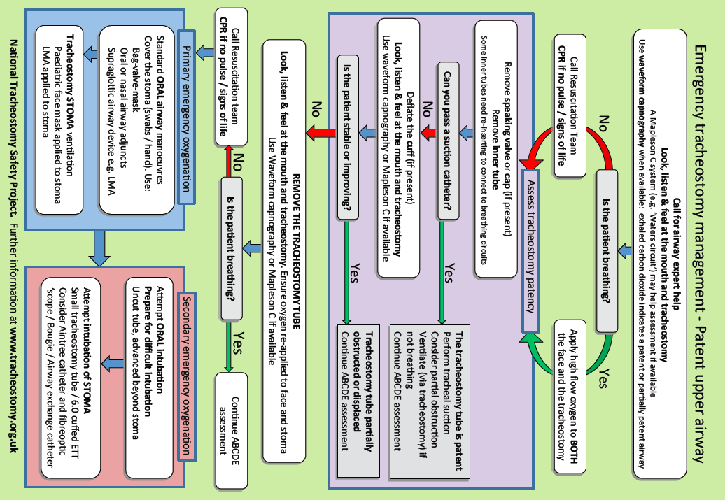
National Tracheostomy Safety Project. Review date 1/1/24. Feedback & resources at www.tracheostomy.org.uk

Slide 4
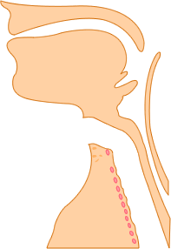
This patient has a LARYNGECTOMY
and CANNOT be intubated or oxygenated via the mouth
Follow the LARYNGECTOMY algorithm of breathing difficulties
Performed on (date) ..............................
Tracheostomy tube size (if present) ...............
Hospital / NHS number ..............................
Notes:
There may not be a tube in the stoma.
The trachea (wind pipe) ends at the neck stoma
Emergency Call: Anaesthesia ICU ENT MaxFax Emergency Team
www.tracheostomy.org.uk

Slide 5
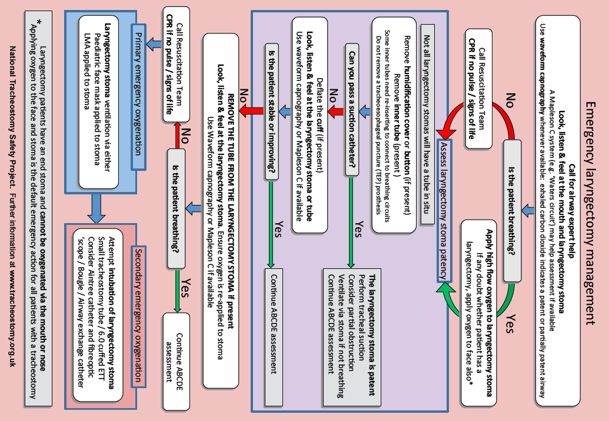
National Tracheostomy Safety Project. Review date 1/1/24. Feedback & resources at www.tracheostomy.org.uk

Slide 6
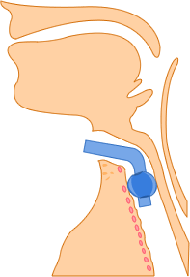
Images for bedhead signs
Surgical window

